Slide 1
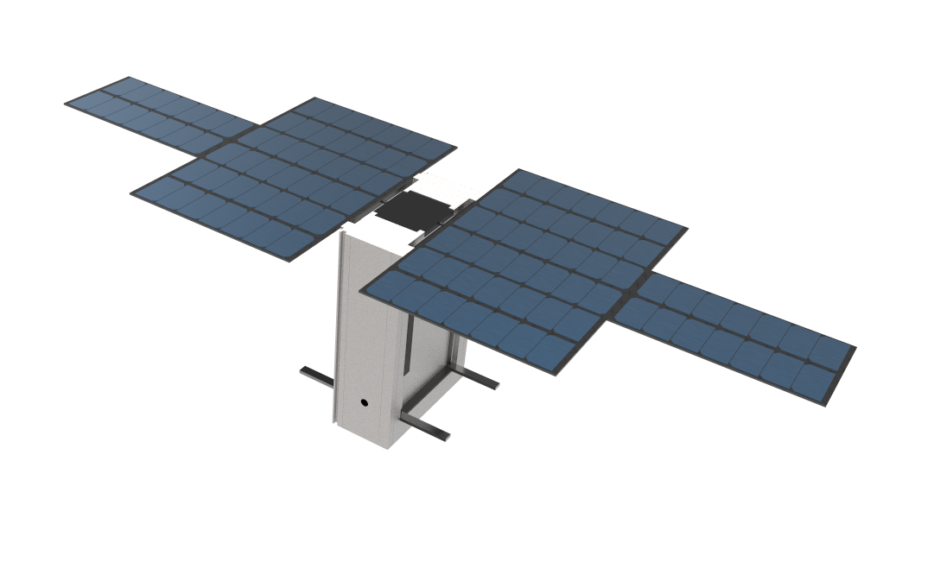
Mechanical and Thermal Design of LunaH-Map
Robert Amzler
Mentor: Dr. Craig Hardgrove

Slide 2


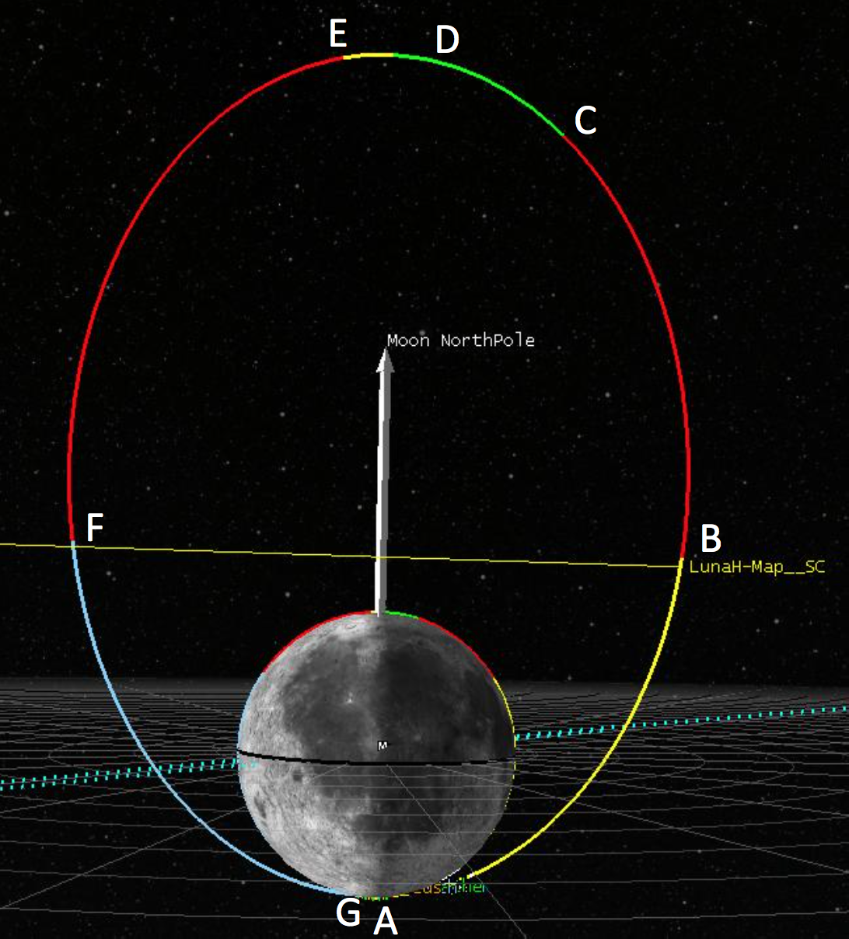
Lunar Polar Hydrogen Mapper
6U Cubesat
Launching in 2018
Map hydrogen using neutron spectrometer
Space Grant Symposium

Slide 3
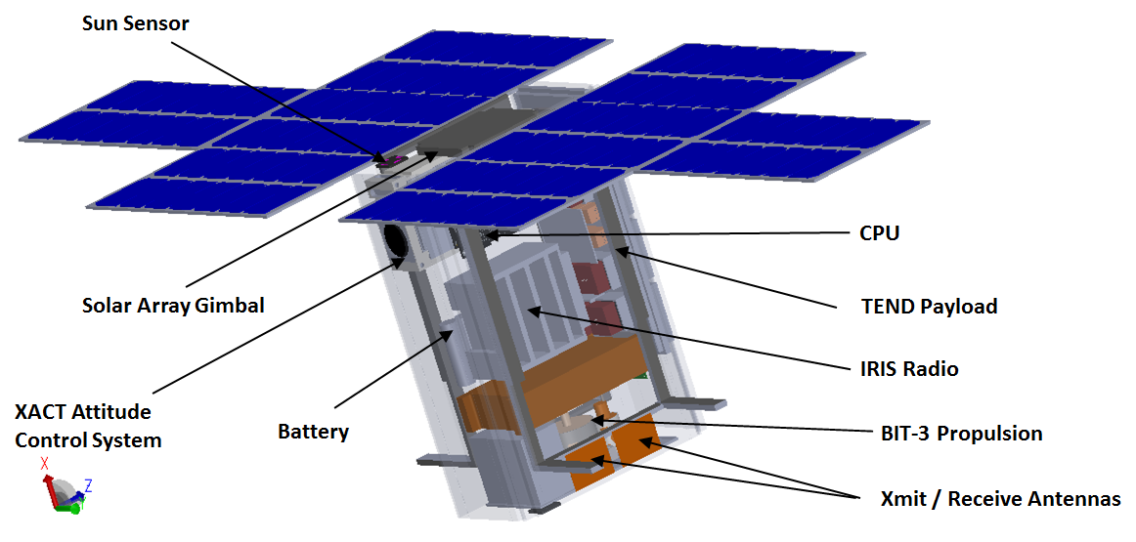
LunaH-Map Spacecraft
Space Grant Symposium

Slide 4
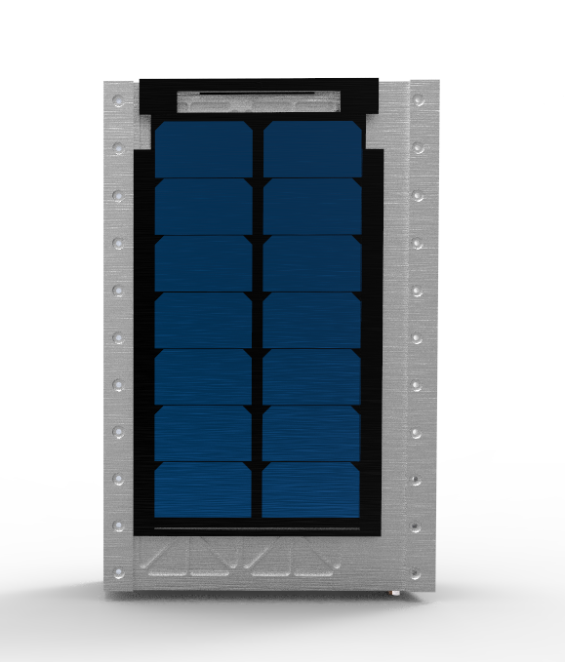
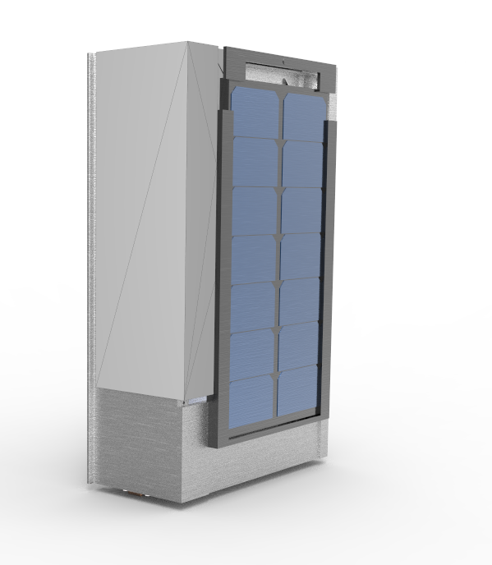
Structure
Space Grant Symposium

Slide 5
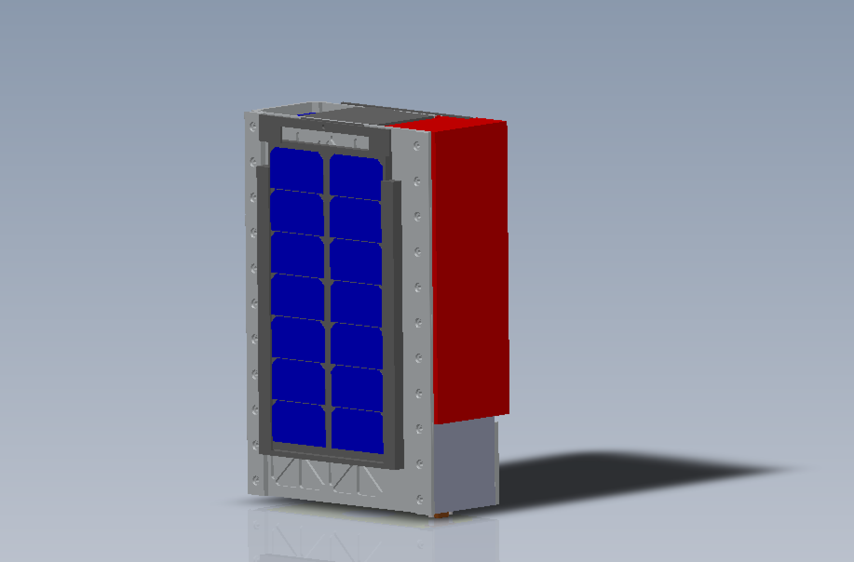
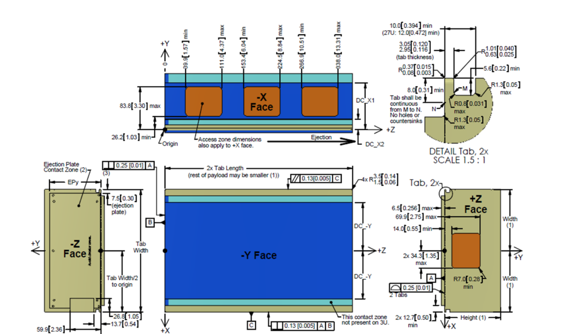
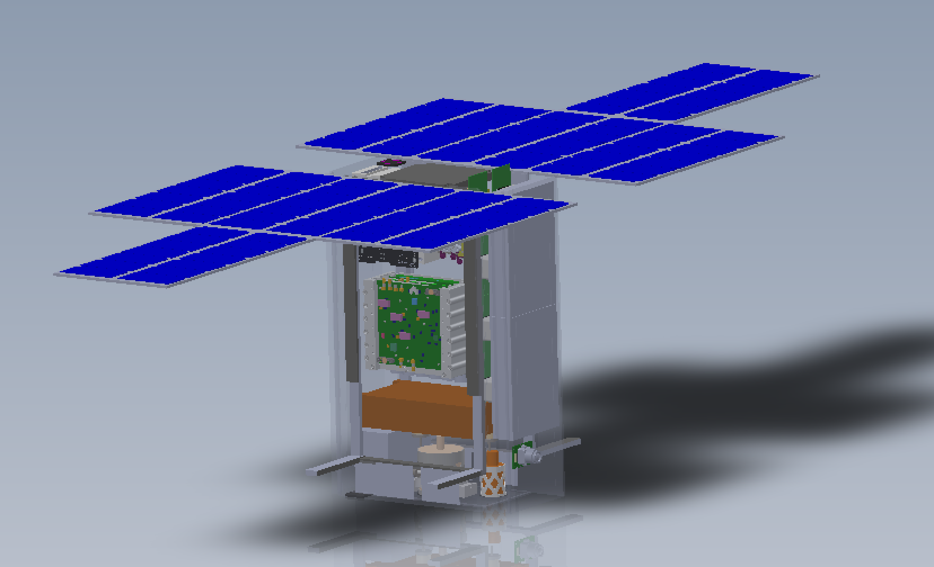
Structural Design Evolution
Starting from design guidelines, moving towards the final flight model.
Specs
Components
Structure

Slide 6
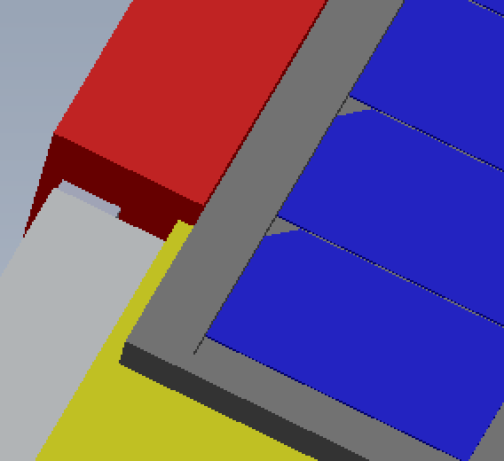
Current Obstacles
Limited interior volume
Science vs. engineering
SLS restrictions
Space Grant Symposium

Slide 7
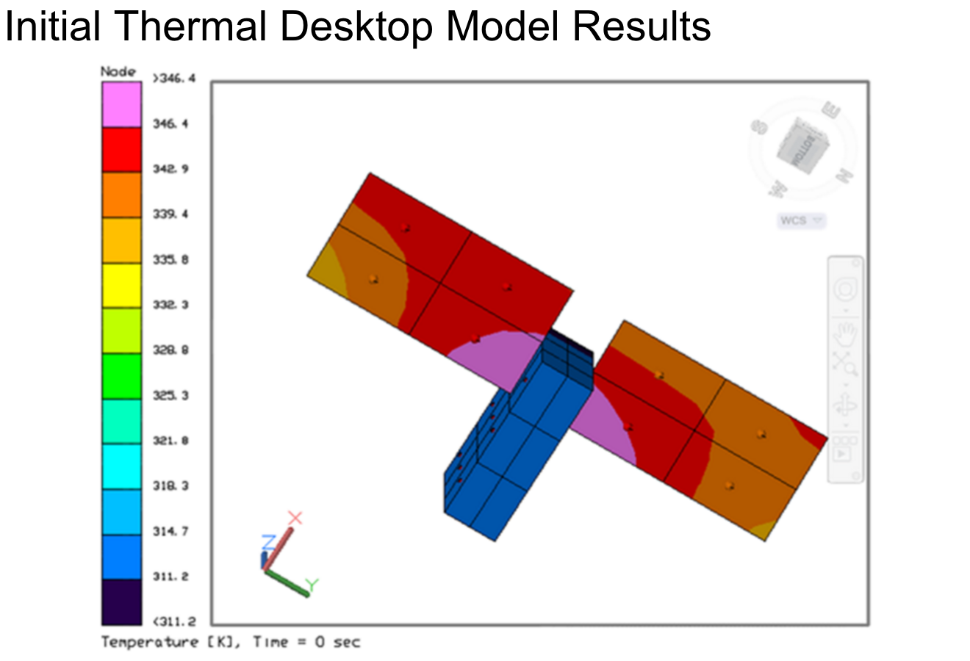
Thermal Analysis
Small platform = big obstacles
Temperature swings in orbit
Significant heat generation
Space Grant Symposium

Slide 8
Future Plans
Continue working with vendors to fit volume constraints
Structure: design, analyze, and refine
Perform vibration and shock testing
Further refining thermal models
Space Grant Symposium

Slide 9
Acknowledgments
JPL, RMD, Busek, and many other vendors for their collaboration.
Dr. Craig Hardgrove, Igor Lazbin, and Valentin Ivanitski for their mentorship.
ASU NASA Space Grant for this incredible opportunity.
Space Grant Symposium

Slide 10
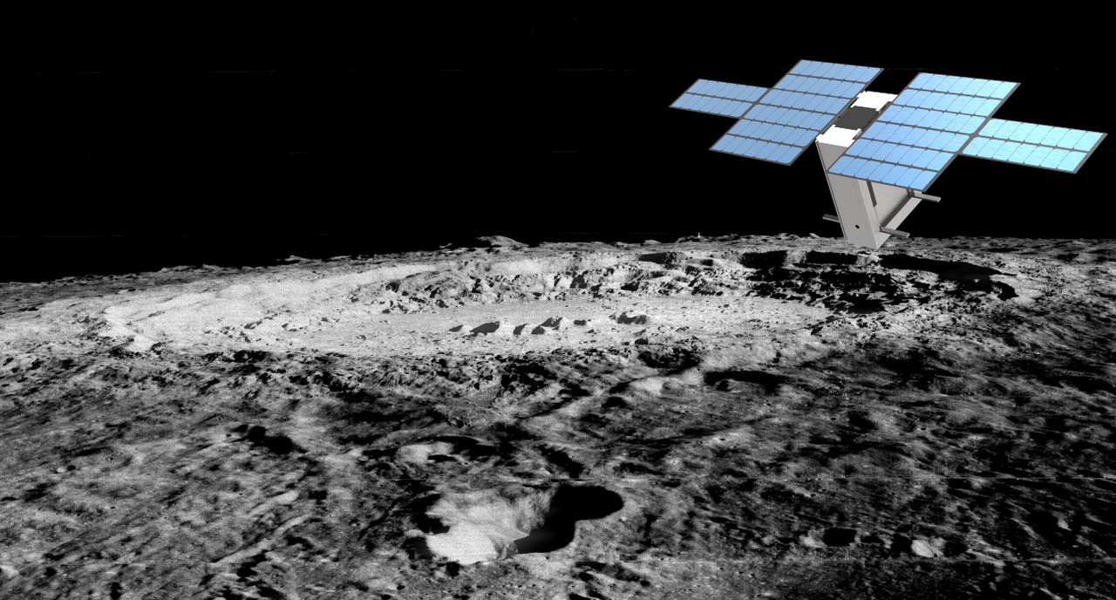
Thank you.

